Slide 1
COMMODITY INVESTMENTS AND RISK
Aum Biyani, Judy Zhijing Wu, Xuan Wu

Slide 2
Commodities role in a portfolio
— a hedge against inflation
Commodity risk reflected in equity share price returns

Slide 3
Introduction
● From the outbreak of the COVID-19, the global recession in early 2020 led to a widespread collapse in commodity prices.
● The collapse was followed by a synchronized sharp rebound in prices.
● Nowadays, with inflationary pressure rising sharply, the Fed has raised interest rates three times in the hope of fighting inflation and high prices

Slide 4
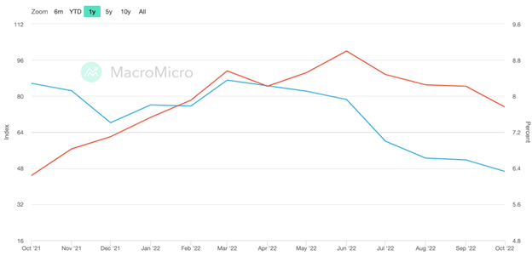
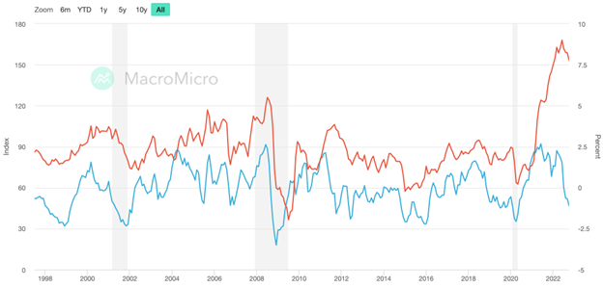
● The manufacturing price index is an ISM (Institute for Supply Management) interview of purchasing managers' views on future commodity prices.
● The rise in commodity prices will affect the production costs of manufacturers, which will be gradually transmitted from upstream to downstream to end customers.
● Finally, it will be reflected in inflation data, which is a leading indicator of US CPI.

Slide 5
Methodology
● We will concentrate on portfolio construction and determine what diversification ratio (equity to commodity) gives us maximum returns with the least amount of risk.
● To measure the above metrics we will determine the alpha, beta and the Sharpe ratio of the portfolio.
● We shall also provide an aggressive portfolio (more risk appetite) and a conservative portfolio (less risk appetite) and create an efficient frontier for data visualization purposes.
● We shall also determine how the presence of commodities in the portfolio affects the equity share price.
● As a unique asset class, we shall determine which commodities would be the best investment choice.
● With the Russia-Ukraine war, and the widely fluctuating oil prices in the past 2 years, we shall put emphasis on the energy sector as well.

Slide 6
Data and Implementation
● We shall source our data either from Yahoo Finance or the Bloomberg Terminal.
● This data shall be split according to our portfolio diversification ratios and then the final risks and returns shall be calculated.
● We shall implement our project using Excel and Python.

Slide 7
Commodities role
in a portfolio
A Hedge Against Inflation

Slide 8
● Commodities are raw materials or agricultural products that can be bought and sold.
● Allocating some of the portfolio to commodities is recommended as it is seen as a diversifying asset class.
● Moreover, some commodities tend to be a good hedge against inflation, such as precious metals and energy products. E.g. Gold, Oil, Cattle, Wheat etc.
● Commodities have a raw value and are independent of any currency. Their intrinsic value helps them perform well during inflation even though equities fall as consumer prices increase.
● As a good hedge, 5-10% of any portfolio should be invested into commodities, with this percentage increasing during times of high inflation and recession.

Slide 9
Benchmarks for Broad Commodity Investing
● Measuring risk tolerance and return expectations.
● Providing a basis for a comparison of your portfolio performance with the rest of the market.
● For commodities, the S&P GSCI Total Return Index is considered a broad commodity index and a good benchmark.
● It holds all futures contracts for commodities such as oil, aluminum, gold, wheat and corn

Slide 10
How Volatile Are Different Commodities
Why Commodities Add Value
● Commodities tend to bear a low to negative correlation to traditional asset classes like stocks and bonds.
● A negative correlation means that when one variable has a low (high) value, the other will have a high (low) value.
● Supply and demand dynamics are the main driver of commodity price changes.
● Some commodities exhibit greater stability than others, such as gold, which is also a reserve asset for central banks to cushion volatility.

Slide 11
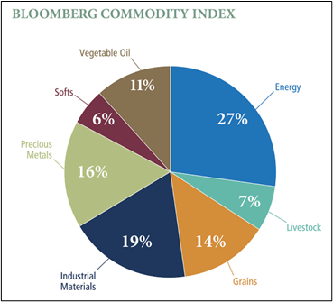
Four Ways to Invest in Commodities
Investing directly in the commodity.
Using commodity futures contracts to invest.
Buying shares of exchange-traded funds (ETFs) that specialize in commodities.
Buying shares of stock in companies that produce commodities.

Slide 12
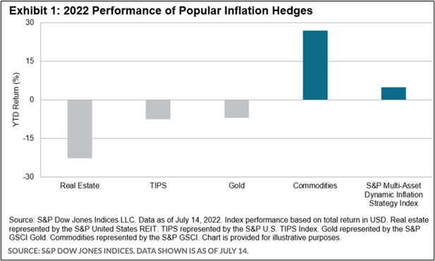

Slide 13
● After U.S. inflation hit its highest level in more than 40 years in June, the dollar is near its highest level in more than two decades against a key index measuring six major currencies, including the euro and Japanese yen.
● The performance of traditional hedging assets has been particularly weak, with real estate, Treasury Inflation-Protected Securities (TIPS) and gold all showing negative values, while the opposite commodities showed a YTD return of around 28%.

Slide 14
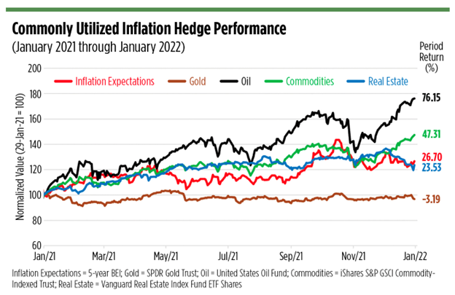

Slide 15
The outperformance of commodities can be attributed to the energy sector.
The rise in these commodities have underlying fundamental reasons such as supply disruptions caused by Russia’s invasion of Ukraine, supply chain issues caused by the pandemic, inclement weather conditions in Brazil supporting soybean prices and seasonal increases in demand such as for gasoline during the summer months in the northern hemisphere, adding to inflationary pressures.
Much of the recent strength in commodities prices can be attributed to supply shocks, including the Russia-Ukraine conflict and post-COVID-19 supply chain disruptions. There's normally an inverse relationship between the value of the dollar and commodities prices.

Slide 16
Commodity Risk Reflected in the Equity Share Price Returns

Slide 17
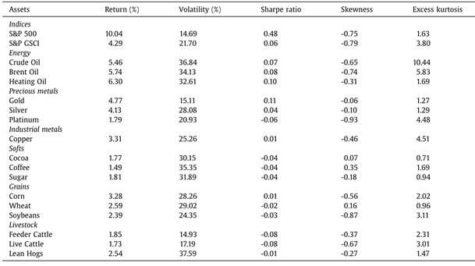

Slide 18
● The table above exhibits descriptive statistics for monthly returns from January 1989 to April 2022, and it can be observed that in the risk-return trade-off, commodities have underperformed relative to stocks, with negative or low Sharpe ratios, lower returns and higher volatility.
● But at the same time, it can be seen that stocks and commodities tend to perform in opposite ways, with commodities performing extremely well during periods of weakness in stocks.

Slide 19
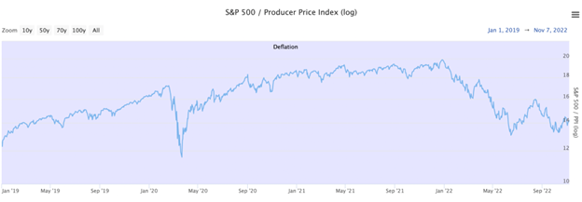
(source:https://www.longtermtrends.net/stocks-commodities-ratio/)

Slide 20
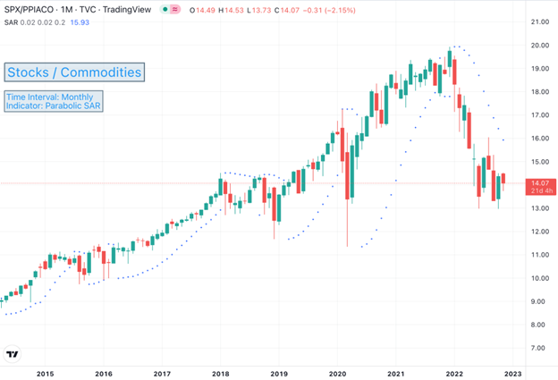
The chart exhibits the stocks to commodities ratio measures the S&P 500 relative to the commodity market index PPI (Producer Price Index). When the ratio rises, stocks beat commodity returns - and when it falls, commodities beat stock returns.

Slide 21
● We can see the commodities have outperformed stocks starting in the first half of 2022.
● In times of inflation, commodities are a better bet than either stocks or bonds because inflation is good for commodities and bad for stocks or bonds.
● Indeed, commodities have been doing well since the inflation scare spread last year.
● But as we mentioned earlier, commodities have always had higher volatility and Sharpe ratios
● After learning about commodity benchmarks and their reaction to stock prices, our team set out to find the best investment strategies for commodities.
● Judging from the market situation, we have concluded that commodities have outperformed stocks, bonds and funds in the first half of 2021 and 2022.
● But there is no guarantee that this will be the case for all commodities.
● After the Russian-Ukrainian conflict three months ago, data showed that energy prices continued to rise, but industrial, precious metals and agricultural prices were the opposite.

Slide 22
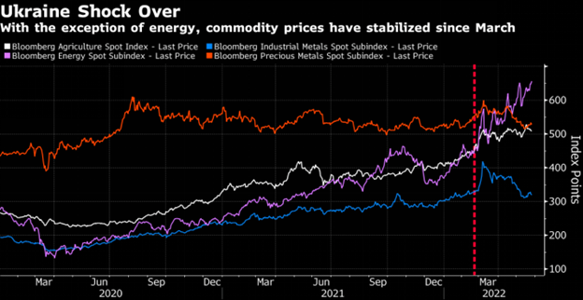
(source from bloomberg)
Since we know that commodities and stocks are negatively correlated, given the risk of investing in commodities over the long term, we think the best way is to add commodities to a portfolio of stocks and bonds and they would act as a diversifier, adding to return while also reducing risk in the form of volatility.

Slide 23
Code

Slide 24
● In part 1, using the S&P 500 and S&P Commodities Index data.
● The aim is to determine the efficient frontier which is a plot of various portfolios with returns and volatility as parameters.
● In this code, we simulate 10000 portfolios and determine the minimum volatility and optimal risky portfolio.
● We first calculate the yearly individual returns and thus determine the portfolio returns by assuming a set of weights.
● We then calculate the annual standard deviation which is also the volatility. (252 used for the number of trading days in a year).
● Next we simulate the portfolio returns, volatility and weights for 10000 portfolios.
● Weights are random numbers but the total sum is 1.
● Thus, we create a dataframe of 10000 portfolios containing the diversification weights, return and volatility.
● The minimum volatility portfolio is as the name suggests the leftmost portfolio on the graph.
● The optimal risky portfolio is the one with the maximum sharpe ratio.
● The Sharpe ratio is defined as the (returns - risk free rate) / volatility.
● Risk free rate is 4.31% which is the 30 year US Treasury bond rate.
● The results are plotted for 1,2,3,5 and 10 years and conclusions are drawn from the same.
● In part 2, a similar approach is used but the data is gold, silver, crude oil, natural gas, live cattle and corn futures.

Slide 25
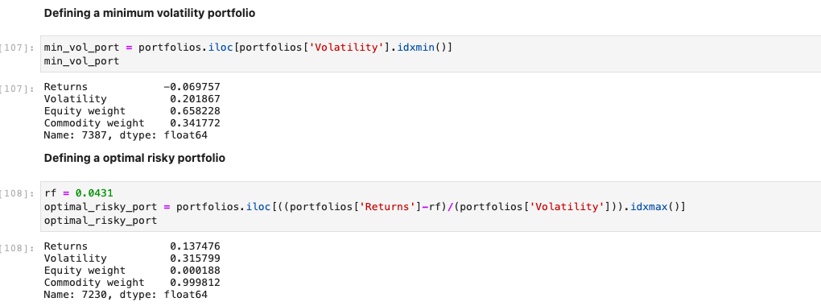
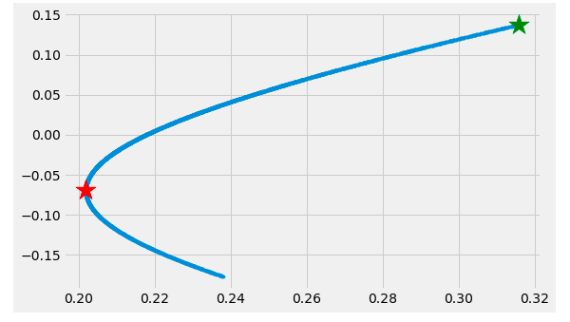
Outputs (Equity vs. Commodity)
1 Year
Negative returns for minimum volatility portfolio as equity has more weightage.
99.9 % weightage given to commodities in the optimal risky portfolio.

Slide 26
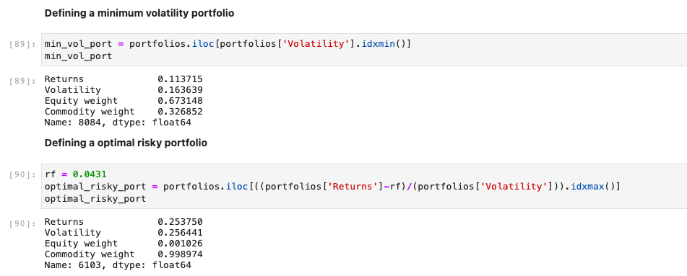
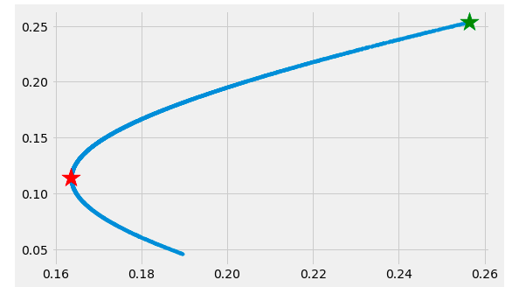
Outputs (Equity vs. Commodity)
2 Year
14% change in returns as almost 99% weightage is given to commodities

Slide 27
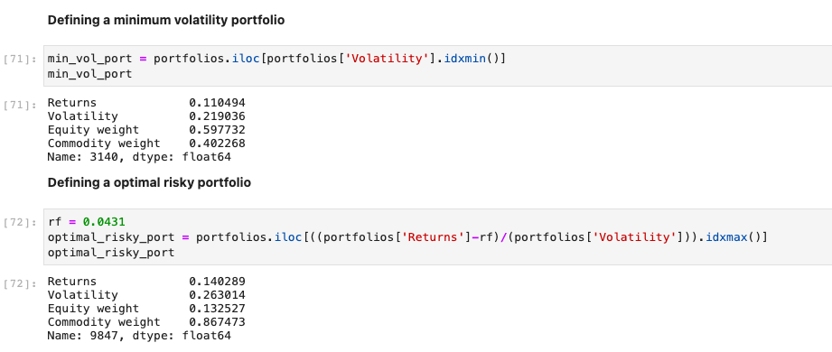
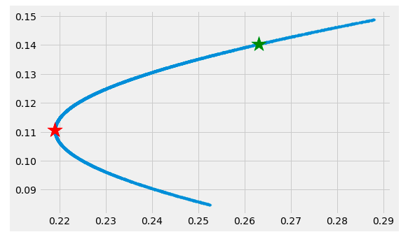
Outputs (Equity vs. Commodity)
3 Year
3% and 5% rise in returns and volatility as more weightage is given to commodities in the optimal risky portfolio.

Slide 28
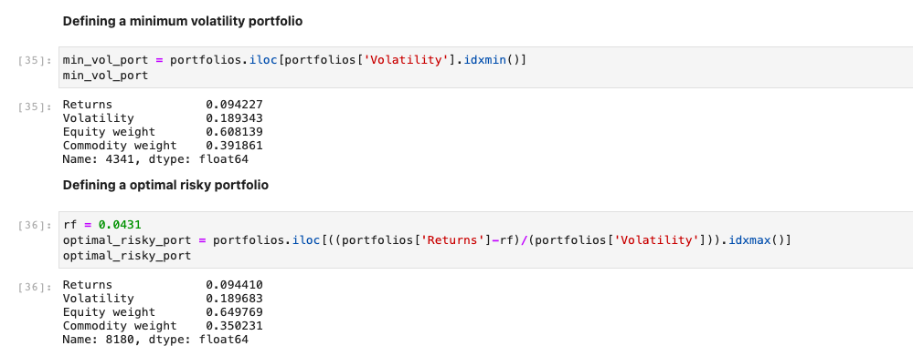
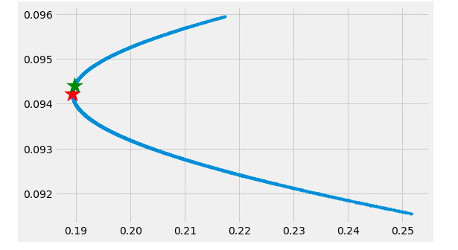
Outputs (Equity vs. Commodity)
5 Year
Almost similar results for both the portfolios.

Slide 29
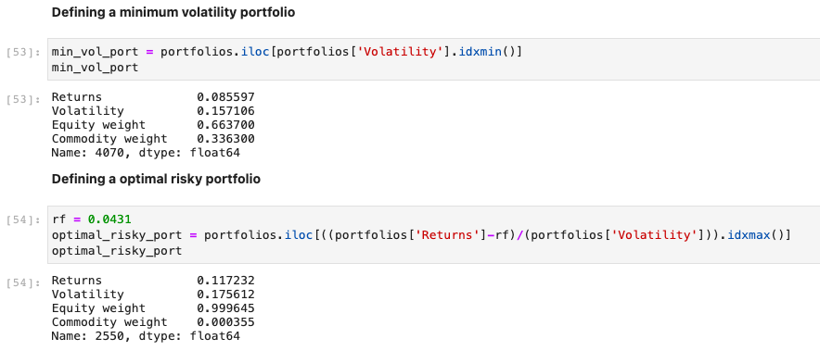
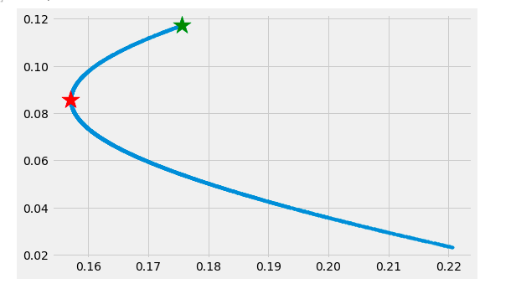
Outputs (Equity vs. Commodity)
10 Year
3% rise in returns as 99% weightage is given to equities in the optimal risky portfolio.

Slide 30

Conclusion
Commodities have a larger short term return and are more volatile than equities which have a larger long term return.

Slide 31
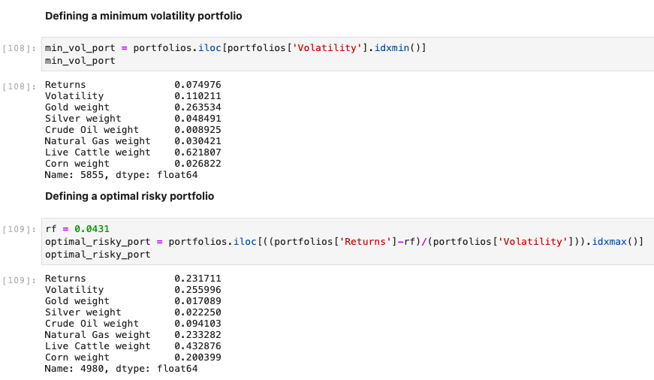
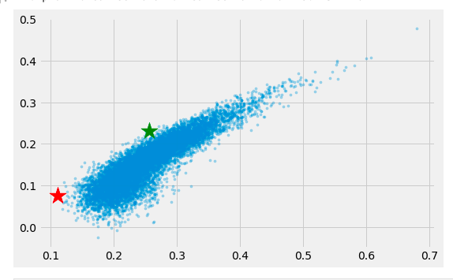
Outputs (Commodities)
1 Year
A 16% and 14% rise in returns and volatility as there is significant weightage rise in natural gas and corn.

Slide 32
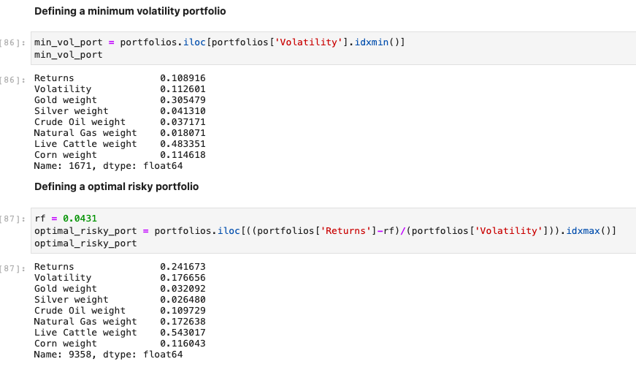
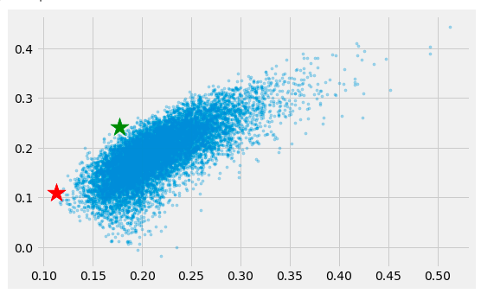
Outputs (Commodities)
2 Year
A 14% and 6% rise in returns and volatility as weightage is transferred from gold to natural gas and crude oil.

Slide 33
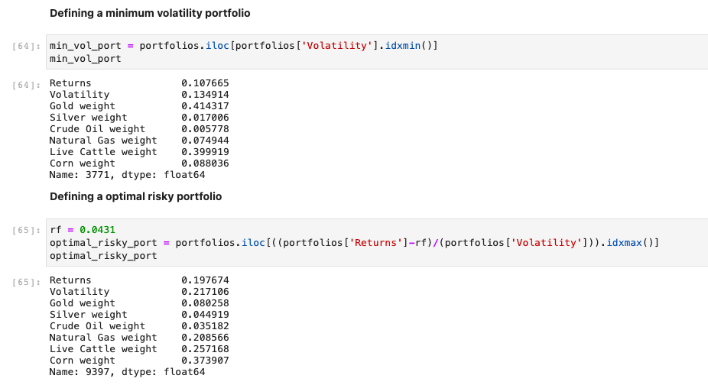
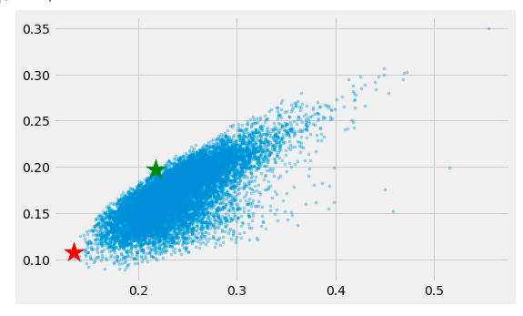
Outputs (Commodities)
3 Year
9% and 8% rise in returns and volatility as significant weightage is transferred from gold to corn.

Slide 34
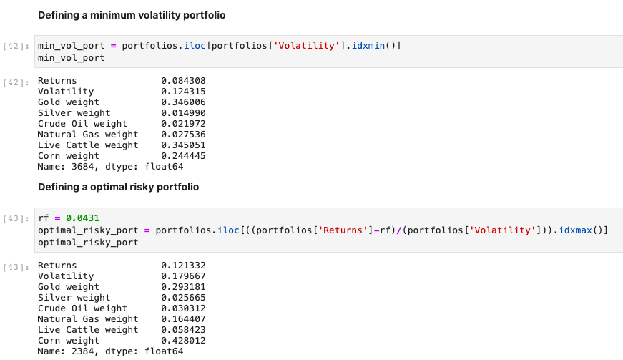
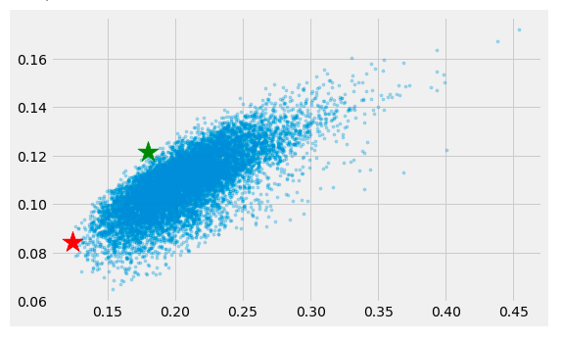
Outputs (Commodities)
5 Year
3% and 6% rise in returns and volatility as there is a significant transfer from live cattle to corn

Slide 35
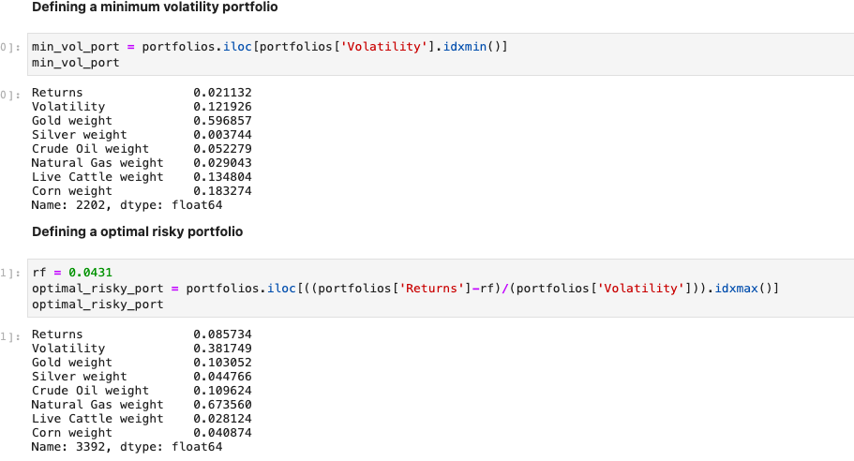

Outputs (Commodities)
10 Year
6% and 28% rise in returns and volatility as there is a significant increase in natural gas.

Slide 36
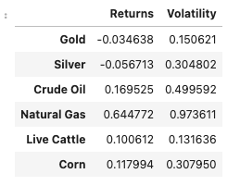
Results
Natural gas has the highest returns but most volatile.
Gold and Live Cattle are the least volatile commodities.
Crude oil and corn have good returns but are volatile as well.
Silver doesn’t affect the results as much.

Slide 37
Conclusion
● We can conclude that commodities and equities move in the opposite direction.
● Commodities are preferred when equity prices are falling and markets are highly volatile, which has been seen in the past 1-2 years with the S&P 500 down 17.5% this year. (Refer to results for 1 and 2 year graphs).
● Over the long run, equities have given a great return (53.5%) and thus, a mix of both these assets is preferred. (Refer to results for 5 and 10 year graphs).
● In commodities, this year has been dominated by the energy sector with rise in the prices owing to the Russia-Ukraine War.
● Metals like gold and silver have given negative returns this year but they are less volatile compared to crude oil and natural gas hence, a good mix should be considered while building the portfolio.

Slide 38
Conclusion
● A plot of all the portfolios is made and returns, volatility and weights are determined.
● In each of our results, we provide two portfolios, one being the least volatile one and the other with the maximum sharpe ratio.
● This gives the investor a choice between choosing a conservative or aggressive portfolio.
● Future Scope: This result is subject to change with the change in parameters like risk free rates etc. Also, we just used simulation in this project and it can be extended by using machine learning techniques like LSTM (Long Short-Term Memory), ARIMA (Auto-Regressive Integrated Moving Average) and genetic algorithms.

Slide 39
Bibliography
“Rethinking Commodities”, Fiona Boal and Jim Wiederhold, The Journal of Alternative Investments Summer 2021, 24 (1) 136-147
“Long-term forecast of energy commodities price using machine learning”, Gabriel Paes Herrera, Michel Constantin, Benjamin Miranda Tabak, Hemerson Pistori, Jen-Je Sua, Athula Naranpanawa, Energy, Volume 179, 15 July 2019, Pages 214-221
“Commodities and portfolio diversification: Myth or fact?”,Ruano, F. and Barros, V., The Quarterly Review of Economics and Finance. Volume 86, November 2022, Page 281-295
“The commodity futures' historical basis in trading strategy and portfolio investment”,Yingjian Pu and Baochen, Yang,5 January 2022
“Dynamic volatility spillovers and investment strategies between the Chinese stock market and commodity markets”, Fenghua Wen, Jiahui Cao, Zhen Liu and Xiong Wang
“The commodities/equities beta term-structure”Atle Oglend, University of Stavanger,10 February 2022.
“Commodities: Inflation, Interest Rates & USD”
“Diversifying With Commodities? Watch How They Roll: John Authers”
“ISM Commodity Prices v/s CPI”

Slide 40
Thanks

